Slide 1
BQ79616 Hot Plug System Analysis
14 Nov 2019

Slide 2
Overview
An worst case analysis of the hot-plug performance of the bq79616 was performed using IC simulation. Full transistor IC hotplug simulations were originally developed for smaller stack sizes, but there is a direct correlation to the results observed in these simulations to an IC configuration where only hotplug sensitive circuits are modeled at transistor level.
This presentation is organized as:
IC Protection Scheme and Analysis
Simulation Coverage
Bench Test

Slide 3
IC Protection Scheme & Analysis

Slide 4
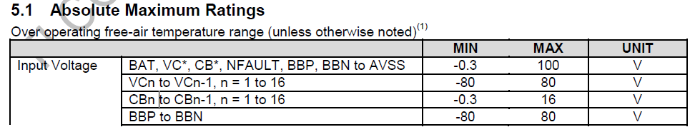
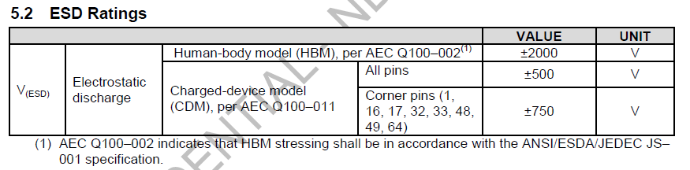
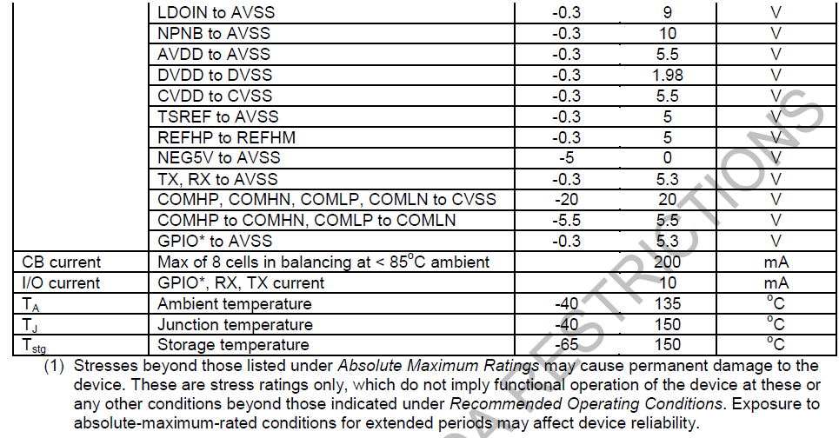
ESD Protection Objectives
The objective of 616 IC ESD scheme is to meet ESD specs (HBM/CDM), and to protect IC against absolute maximum ratings.

Slide 5
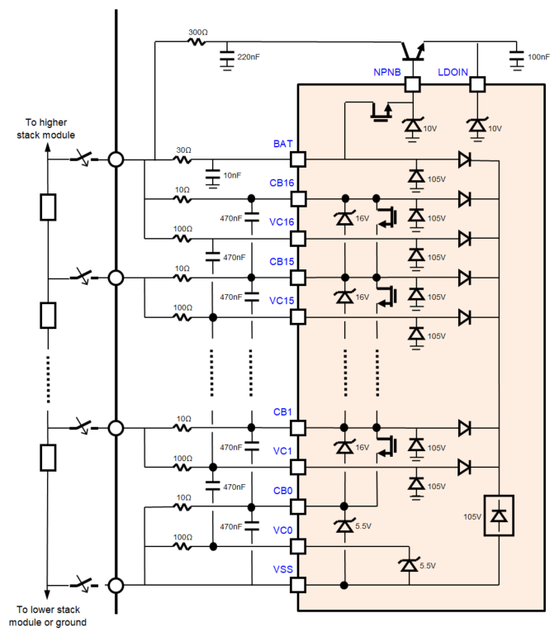
Overall Protection Scheme – CB/VC/BAT/LDOIN pins
During a stack cell hot-plug event:
The pin current and pin voltage transients are defined by the selection of the external RC components and the internal diode network for each IC (which connects to 16 cells) in the stack.
The hot-plug robustness is achieved by a proper selection of the RC network to ensure that:
The voltage between VC(n) – VC(n-1), VC(n) – VSS, CB(n) – CB(n-1), CB(n) – VSS does not exceed the “DC” ESD voltage ratings
The currents in/out of IC pins do not exceed ~500mA for more than 5usec during voltage transients after hot-plug

Slide 6
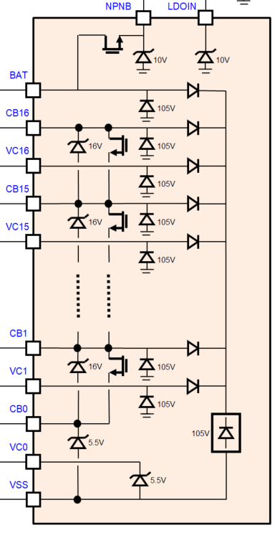
ESD Protection Analysis
Below shows a few scenarios of how ESD network is activated during ESD stress.
Between BAT, CBx, VCx
From BAT/VCx/CBx to GND
From BAT/VCx/CBx
to NPNB/LDOIN
Between CBx and CBx-1

Slide 7
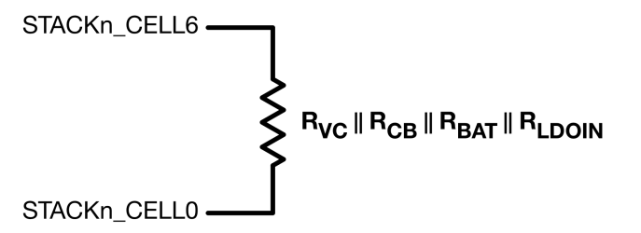
16 Cells - Hotplug Worst Case of Max Current
The equivalent RC circuit between top cell and bottom cell can be modeled as:
STACKn_CELL16
STACKn_CELL0
When the IC chain has the top cell and bottom cell connected sequentially, the initial current transient flows through the external RC network, and then the V(DEVICEn) voltage is equally distributed across the external VC, CB filter capacitors of that device.
This is the same current distribution observed for any device in the IC chain with a similar connection sequence (IC top cell ➙ IC cell0).
For a very short period of time after the ground is connected, measured in µsec, the internal ESD bus is activated, and a transient current flows from the uppermost CB pins (CB16,CB15) to the IC substrate.

Slide 8
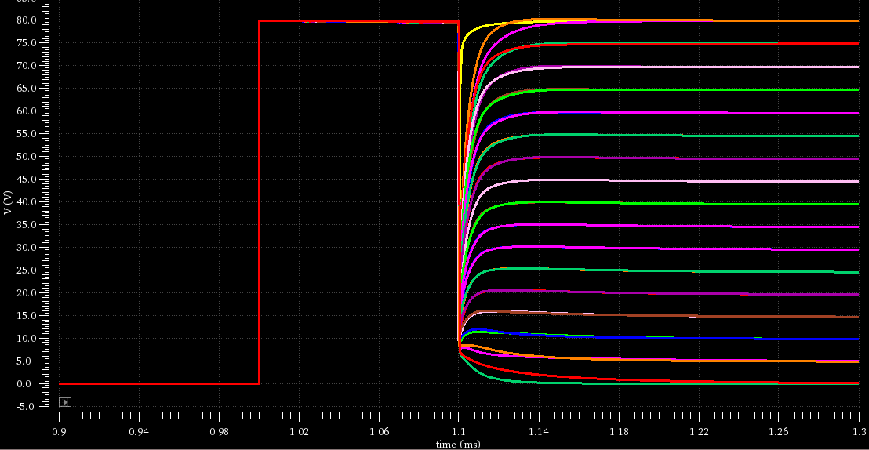
16 Cells – Max Current Simulation
When BAT (cell 16) is first connected, Initially, all IC terminals, including ground reference are floating up to 80V
The moment the ground (cell 0) is connected, 80V is distributed across the entire channels via RC network

Slide 9
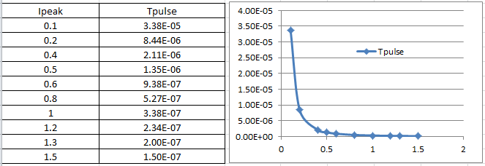
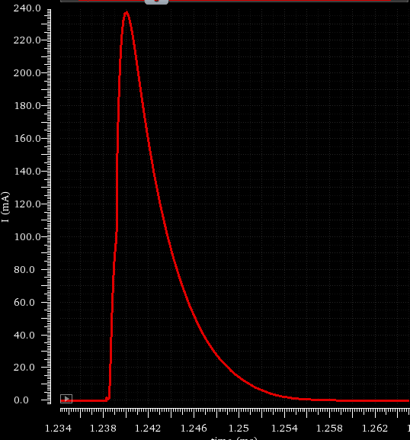
How to calculate the margin to rectangular pulse Ipeak?
The maximum peak current for a rectangular pulse is : Ipeak = 1.5*SQRT( 150nsec/Tpulse) Using this equation the maximum pulse width can be calculated as follows:
The area under a rectangular pulse that meets this criteria is: Ipeak*Tpulse= f(Ipeak) = ( 337e-9/ Ipeak )
The area for a non-rectangular pulse can be scaled to a rectangular pulse meeting this criteria as:
Iscale = [ Integ(Itransient)*Ipeak ] / (337e-9) , Iscale < 1
Used for dvdt ESD and ESD diodes !

Slide 10
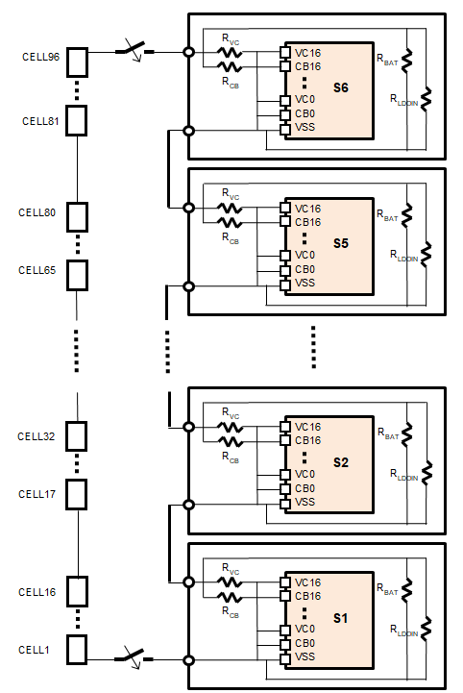
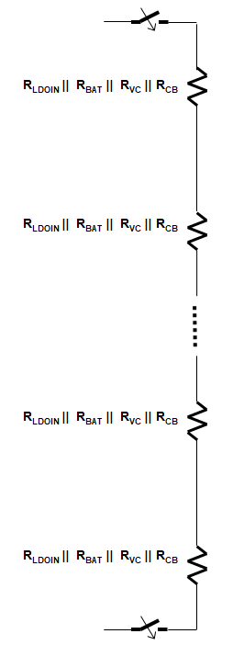
96 Cells Worst Case of Max Current – Cell 96 to Cell 0
Ipeak=10.6A
A board (module) that has a hotplug path from the positive terminal to the negative terminal can be modeled as follows:
Assumptions:
Vcell=4.5V
RVC=100Ω
RCB=10Ω
RBAT=30Ω
RLDOIN=300Ω
The voltage applied to each device at the connector is shown below:
V(S6)=V(S5)=72V @t=0, applied to RCB,RVC resistors connected to C5=VC6,CB5=CB6 pins.
(2)V(S11) = 72V @t=0, applied to RCB16,RVC16 resistors connected to VC4=VC5=VC6, CB6=CB4=CB4 pins. After the initial connection this voltage charges the RC network, and in steady state the voltage at IC pins is 72V for each device.

Slide 11
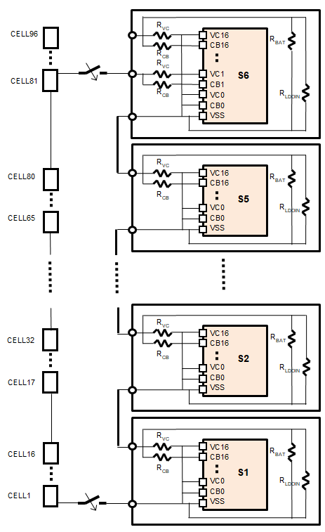
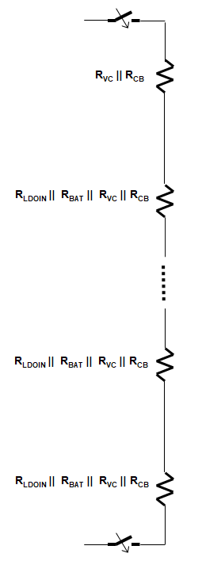
96 Cells Worst Case of Max Voltage – Cell 81 to Cell 0
Ipeak=8.77A
A board (module) that has a hotplug path from S6, cell 1 terminal to the negative terminal can be modeled as follows:
Assumptions:
Vcell=4.5V
RVC=100Ω
RCB=10Ω
RBAT=30Ω
RLDOIN=300Ω
V(S6)=65.7V @ t=0, applied to RCB,RVC resistors connected to VC1,CB1 pins.
The combined operation of the bq79616 RC network connected to VC1,VC0,CB1,CB0 pins and internal circuits of the S6 IC “shunt” the S6 hot plug current around its RC network to ensure that the final voltage at VC1, CB1 pins does not exceed the ESD ratings.
This is the worst case for transient voltage on the pin, but it does not exceed the ESD voltage
V(S5)=V(S4)=V(S3)=V(S2)=V(S1)=59.8V @t=0, applied to RCB16,RVC16 resistors connected to VC16,CB16 pins.
After the initial connection this voltage charges the RC network.

Slide 12
Bench Test

Slide 13
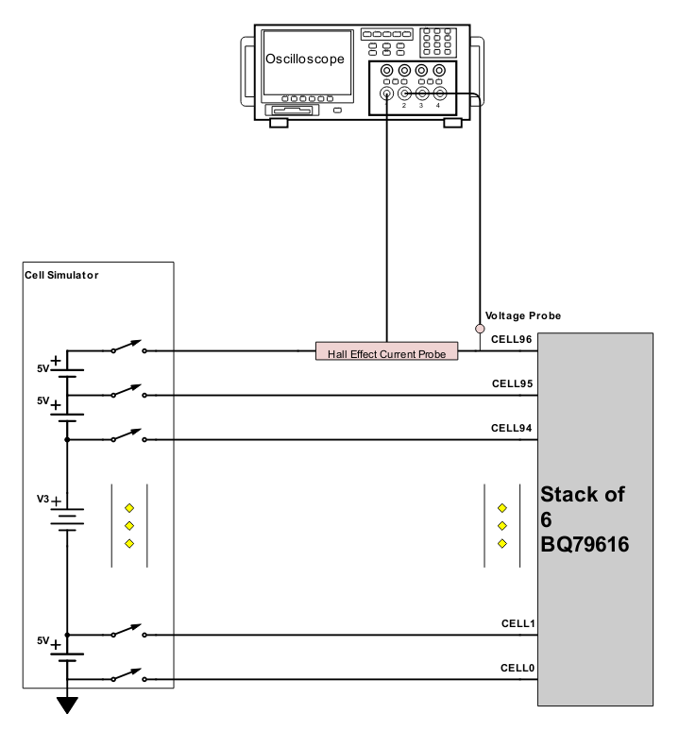
96S Hotplug Setup
Setup
5V applied per cell
Each connection has a relay between cell and BQ79616 hotplug board
Test loop for taking current measurement on select pins (BATT, BBP, BBN and Cells 16, 14, 12, 8, and 6 for each IC). Pin for current measurement is determined by sequence being run
Cells are closed in order of test sequence.
Current and voltage measurement at DUT
5V
5V
5V

Slide 14
96S Hotplug Sequences
Sequence 1 | Sequence 2 | Sequence 3 | Sequence 4 | Sequence 5 | Sequence 6 | Sequence 7 | Sequence 8 | Sequence 9 | Sequence 10 | Sequence 11 | Sequence 12 | Top to Bottom | Bottom to top | Evens First | Odds First
96 | 81 | 89 | 48 | 33 | 41 | 0 | 0 | 0 | 0 | 0 | 0 | 96 | 0 | 96 | 95
0 | 0 | 0 | 0 | 0 | 0 | 96 | 81 | 89 | 48 | 33 | 41 | 95 | 1 | 94 | 93
95 | 96 | 96 | 96 | 96 | 96 | 95 | 96 | 96 | 96 | 96 | 96 | 94 | 2 | 92 | 91
94 | 95 | 95 | 95 | 95 | 95 | 94 | 95 | 95 | 95 | 95 | 95 | … | … | … | …
… | … | … | … | … | … | … | … | … | … | … | … | 2 | 94 | 5 | 4
2 | 2 | 2 | 2 | 2 | 2 | 2 | 2 | 2 | 2 | 2 | 2 | 1 | 95 | 3 | 2
1 | 1 | 1 | 1 | 1 | 1 | 1 | 1 | 1 | 1 | 1 | 1 | 0 | 96 | 1 | 0
Sequences are connected in the order above
Test cases are defined by the worst case simulations
Top to GND worst case current (Sequence 1)
Cell 1 of top device to GND worst case voltage (Sequence 2)
Additional test cases added to capture generic test cases
Top to bottom
Bottom to top
Evens first
Odds first
17 Total sequences looped
Worst case sequences #1 and #2 looped 100x
Other sequences looped 10x

Slide 15
96S Hotplug Results
Units are run through production test pre and post hotplug
3 Unique stacks of 6 BQ79616 were run through hotplug testing
All 18 units passed post-hotplug production test

